Slide 1
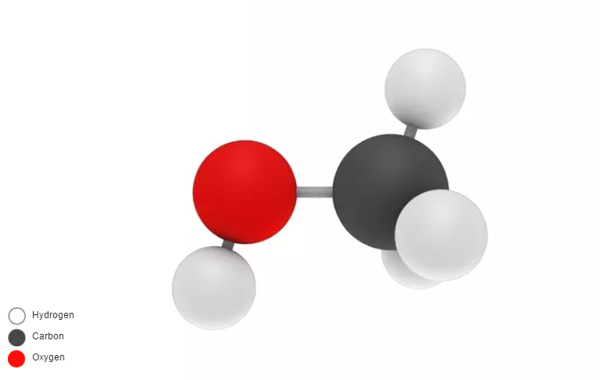
METHANOL (CH₃OH) small scale Production for NG consumption
.
Presented By: Mr. Govind Ghule & Mr. Sagar Panchal

Slide 2
Introduction
Methanol is the simplest alcohol, being only a methyl group linked to a hydroxyl group . It is a light, volatile, colorless, flammable liquid.
Methanol is highly toxic .At room temperature, it is a polar liquid, and is used as an antifreeze, solvent, fuel, and as a denaturant for ethanol. It is also used for producing biodiesel .
It is primarily used in making other chemicals. About 40% of methanol is converted to formaldehyde, and from there into products as diverse as plastics, plywood, paints, explosives, and permanent press textiles.
Methanol is occasionally used to fuel internal combustion engines. As a fuel for mud racers, methanol mixed with gasoline and nitrous oxide produces more power than gasoline and nitrous oxide alone.

Slide 3
Demand & Supply for methanol
India is a large importer of methanol. Due to insufficient domestic production
Domestic methanol production has increased by 13% in FY11, reflecting improvement in utilization rates by players such as Deepak Fertilizers& Petrochemicals Corporation Ltd (Deepak Fertilizers), Gujarat Narmada Valley Fertilizers Company Ltd (GNVFC) and Rashtriya Chemicals & Fertilizers Ltd (RCF).
Demand for methanol has increased at a CAGR of 8% from 0.87 mmtpa in FY06 to 1.26 mmtpa in FY11. The domestic production of methanol is not sufficient to meet the demand of methanol in India. As a result, in FY11, the net import of methanol was 0.92 mmtpa i.e. ~2.5 times the domestic production of 0.38 mmtpa. Import of methanol has increased at a high CAGR of 18% from 0.4 mmtpa in FY06 to 0.92 mmtpa in FY11.
mmtpa----Million metric tons per annum

Slide 4
Availability of NG and Production Methanol
GAIL NG contractual supply qty 100000 scm/day
VVF NG consumption Max qty. 90000 scm/day
Available of Natural Gas 10000 scm/day

Slide 5
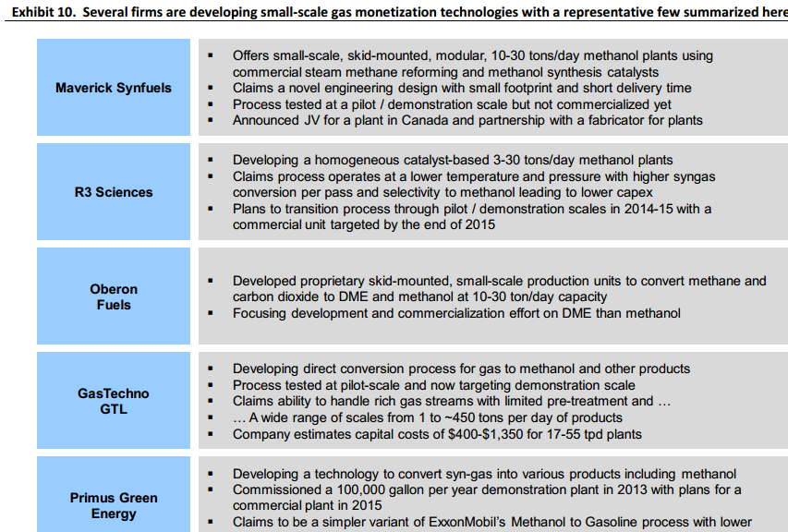

Slide 6
GasTechno Features:
Small Scale Solution Gas Techno plants are scalable and transportable with the ability to profitably operate at small volumes, allowing even modest point sources to meet carbon reduction goals.
Affordable Gas Techno plants are up to 70% lower in capital costs than traditional methanol plants at commercial scales. Operating costs are also reduced by an estimated 20% or more.
The GasTechno® process is a non-catalytic gas-to-liquids technology that converts methane to methanol in one step. Developed by alternative energy company Gas Technologies LLC, GasTechno® is an economic gas conversion platform for small scale producers.’
"GTL In A Box" or "Methanol In A Box" (since it is housed in a 40-foot shipping container), the Mini-GTL plant is an ideal and economically viable option

Slide 7
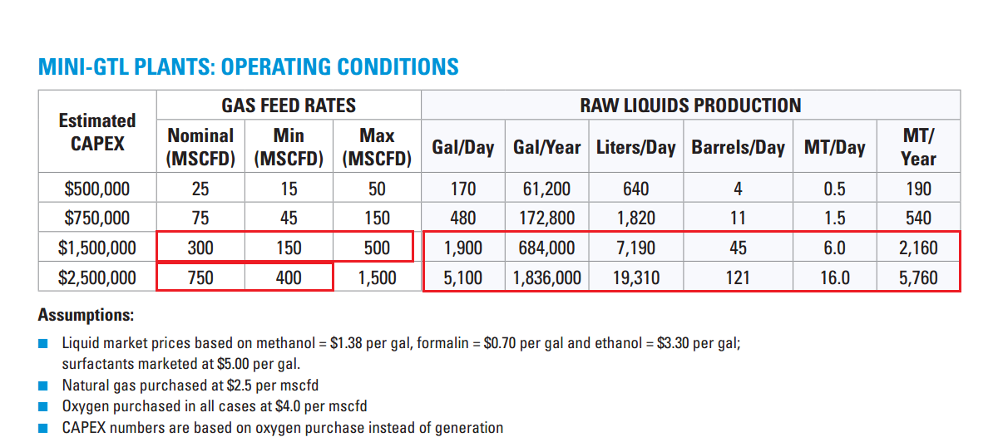

Slide 8
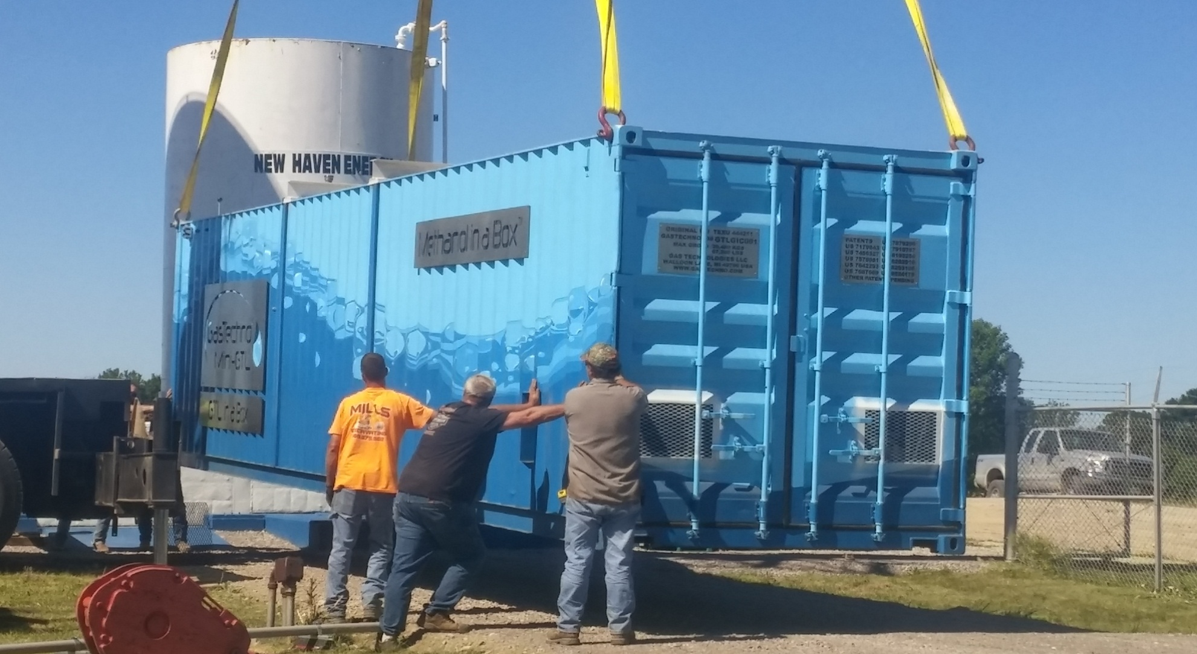
Tentative Plot size area required to install plant.---300 ft x 300 ft

